Slide 1
Benchmarking Computational Methods for Cancer Cell Lineage Tracing
Alex Mistretta (asm348), Alyssa Serebrenik (ars387), Claire McHugh (cdm234), Ena Kovac (ehk75), Jake Berko (jmb787), and Sophia Mulvania (sam563)

Slide 2
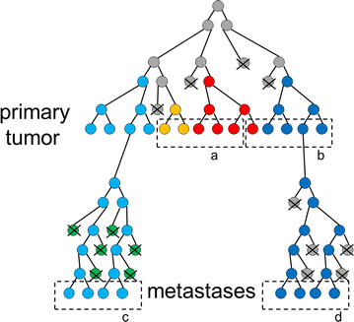
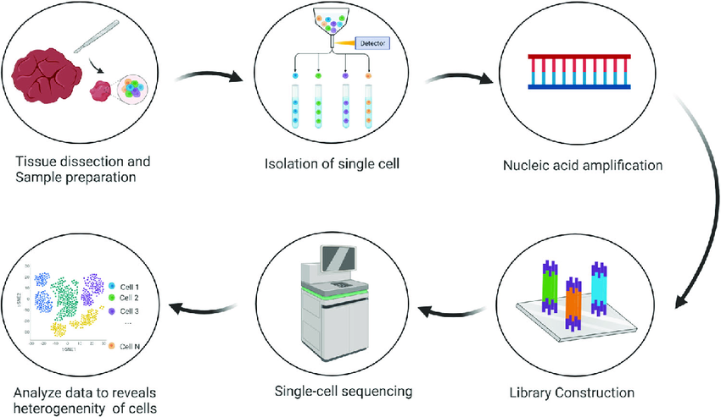
Why Study Tumor Lineages? (Biological Motivation)
Cancer is an evolutionary process; tumors arise from a single cell and diversify through mutations
Understanding clonal evolution helps identify treatment-resistant subpopulations and predict relapse
Single-cell sequencing enables direct observation of heterogeneity, but inferring evolutionary relationships is still challenging
Accurate lineage reconstruction reveals how driver mutations (e.g., TP53, KRAS, PIK3CA) shape tumor progression
Single-cell sequencing provides the raw data (mutations + expression) used to infer tumor lineage trees
Single-cell sequencing allows us to observe heterogeneity directly … but accurate lineage reconstruction remains difficult due to dropout, noise, mutational sparsity, and copy-number alterations
This motivates our benchmarking project: Which computational methods best reconstruct tumor evolution from single-cell data?
Notes:
Notes: Motivation
Cancer is an evolutionary process: tumors begin from a single cell and diversify through accumulating mutations.
Reconstructing this clonal evolution helps identify resistant subpopulations and predict relapse.
Single-cell sequencing captures tumor heterogeneity at high resolution. But noisy mutation profiles — dropout, false positives, sparsity, complex mutation patterns — make lineage reconstruction difficult.
So, our core question is
Which computational methods most accurately reconstruct a tumor’s lineage from the same single-cell mutation data?
By benchmarking them side by side, we see how different modeling assumptions directly influence the evolutionary trees they produce.

Slide 3
Methods Overview
Real data via Monocle3 (exploratory only)
Used Monocle3 on a real breast-cancer scRNA-seq dataset to learn pseudotime and branching structure from expression, not from mutations
Monocle3 is a separate “biological motivation / context” result, not part of the synthetic benchmark
Generate synthetic lineage data with ground truth
Built three synthetic trees (balanced, mixed, comb) and corresponding cell × mutation matrices
For this presentation we focus on the balanced dataset as the clean benchmark
Run mutation-based lineage methods on the synthetic data
Evaluated on the balanced synthetic matrix: SCITE, SiFit, PhISCS-BnB, Neighbor-Joining
Additional methods were attempted, but did not produce stable or interpretable trees
Comparison to ground truth
For each method, we plotted its inferred tree and compared it visually to the balanced truth tree (depth, symmetry, major clades, over-/under-splitting)
Quantitative metrics (RF distance, ARI, edge precision/recall) are planned in next steps
Notes:
We started by using Monocle3 on a real breast-cancer dataset to get a sense of what real tumor branching looks like, but that analysis was purely exploratory — Monocle3 infers expression-based trajectories, so it’s not part of our mutation-based benchmark.
For the actual evaluation, we generated synthetic datasets with known ground-truth lineages — including balanced, mixed, and comb trees — and for this presentation we focus on the balanced dataset as the cleanest baseline.
We then ran four mutation-based reconstruction methods.
Finally, we compared each inferred tree to the true balanced tree, looking at depth, symmetry, and major clades. Quantitative metrics are part of our planned next steps

Slide 4
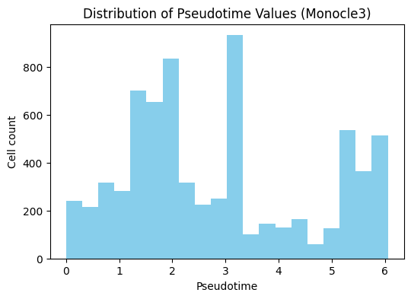
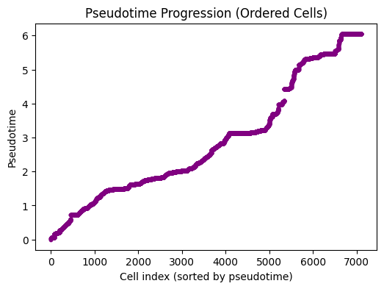
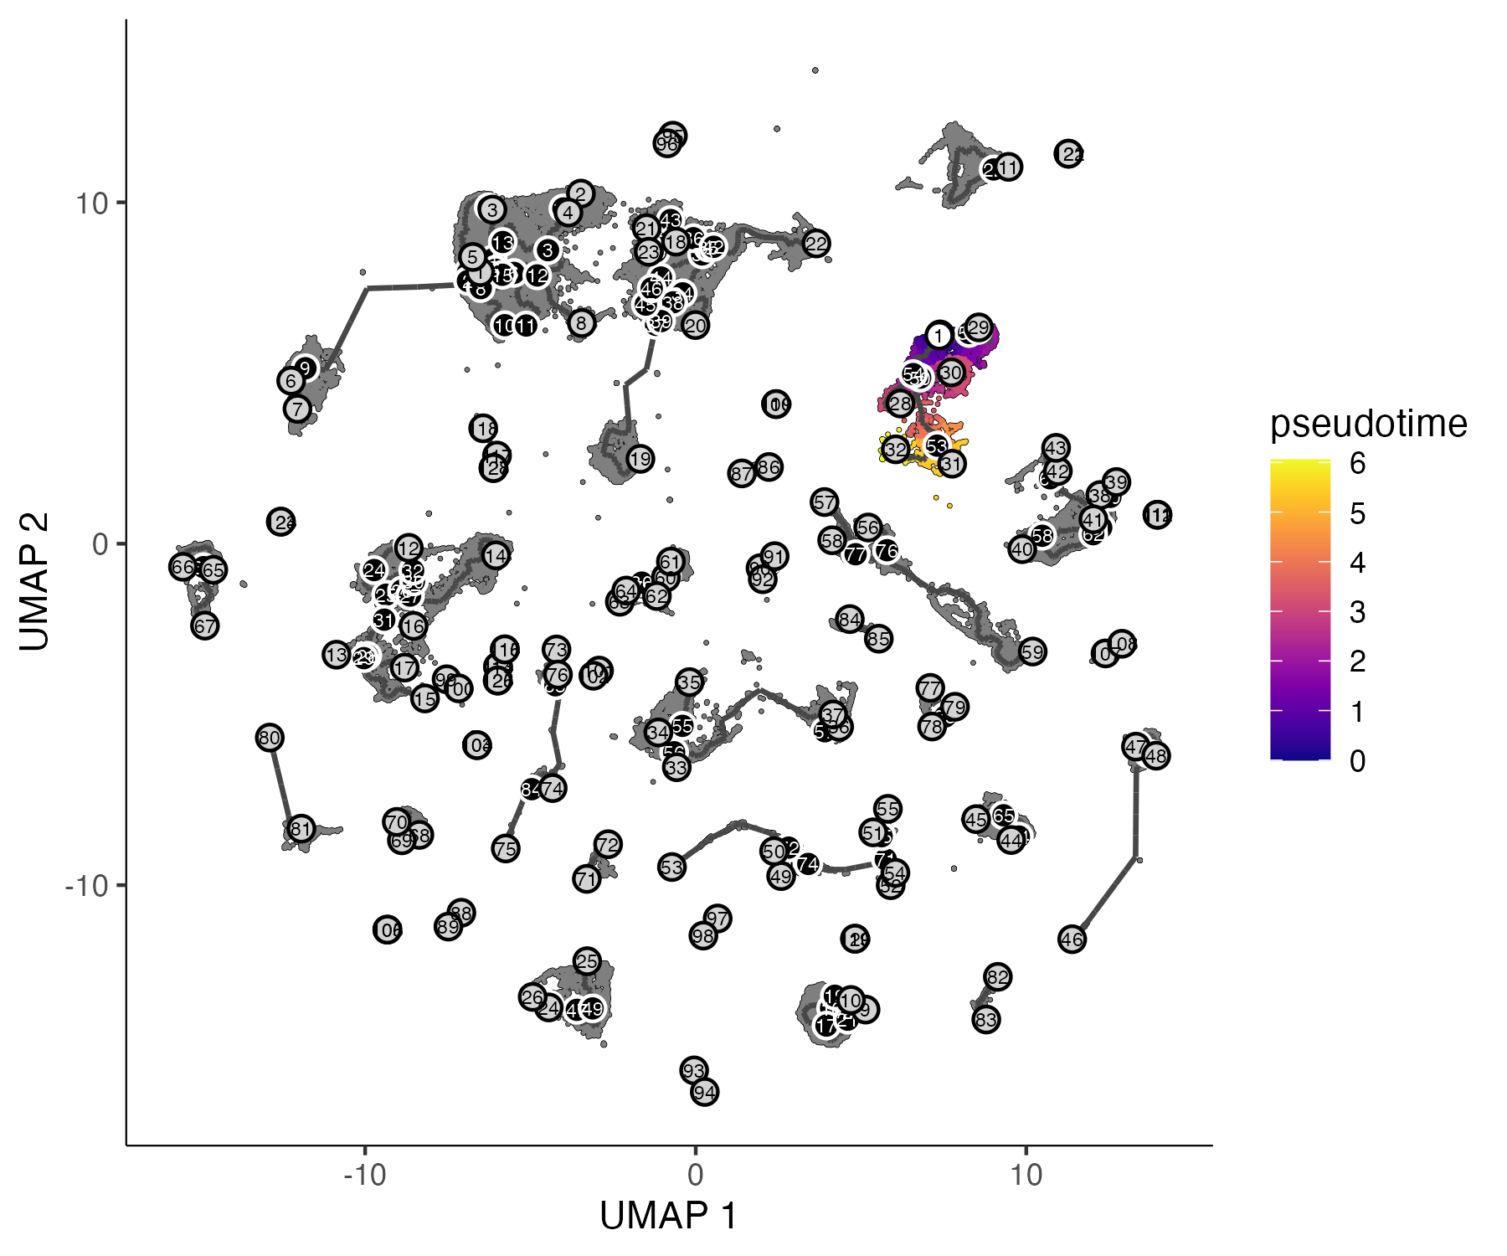
Monocle3 - Real Data Results
Monocle3 reveals pseudotime structure and branching trajectories in real breast cancer data, suggesting evolving subpopulations
Monocle3 Findings: | Why this matters:
Reveals clear branching structure → multiple cell subpopulations Shows a continuous pseudotime progression → potential tumor evolution path | Provides biological context before running lineage algorithms Helps validate whether inferred mutation trees match real functional structure
Notes:
Before evaluating any reconstruction algorithms, we wanted to understand what real tumor evolution looks like.
We saw that cells follow a smooth progression in pseudotime and form distinct regions in expression space.
This suggests structured biological transitions, but not a clean, discrete lineage tree
And that’s important, because the methods we benchmark next all make different simplifying assumptions about how evolution works.
Comparing them helps us understand how those assumptions shape the trees they recover

Slide 5
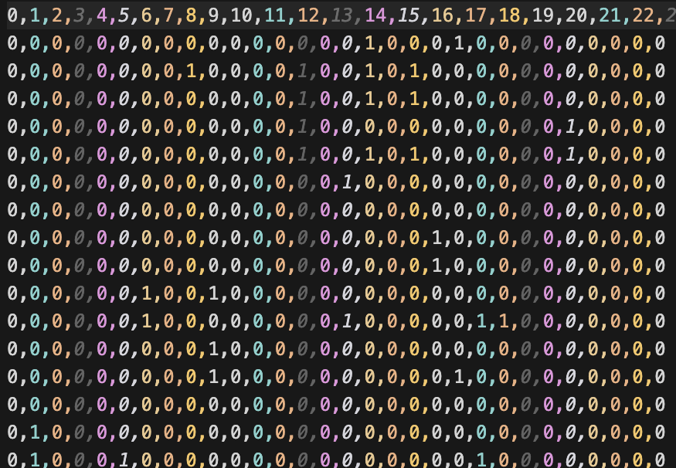
Synthetic Dataset Generation
Goal: Create controlled, ground-truth lineage
datasets to benchmark lineage tracing algorithms
Process:
1. Build lineage tree - Generate a random tree structure, Three shapes: balanced (every split symmetrical), comb (uneven splitting), mixed
2. Generate cell x mutation matrix - Traverse each cell’s path from root to leaf, collect all inherited mutations. Rows = cells, columns = mutations. 1 if mutation is present, 0 if not.
3. Group leaves into clones based on shared mutations
4. Apply Noise models to simulate real sequencing imperfections

Slide 6
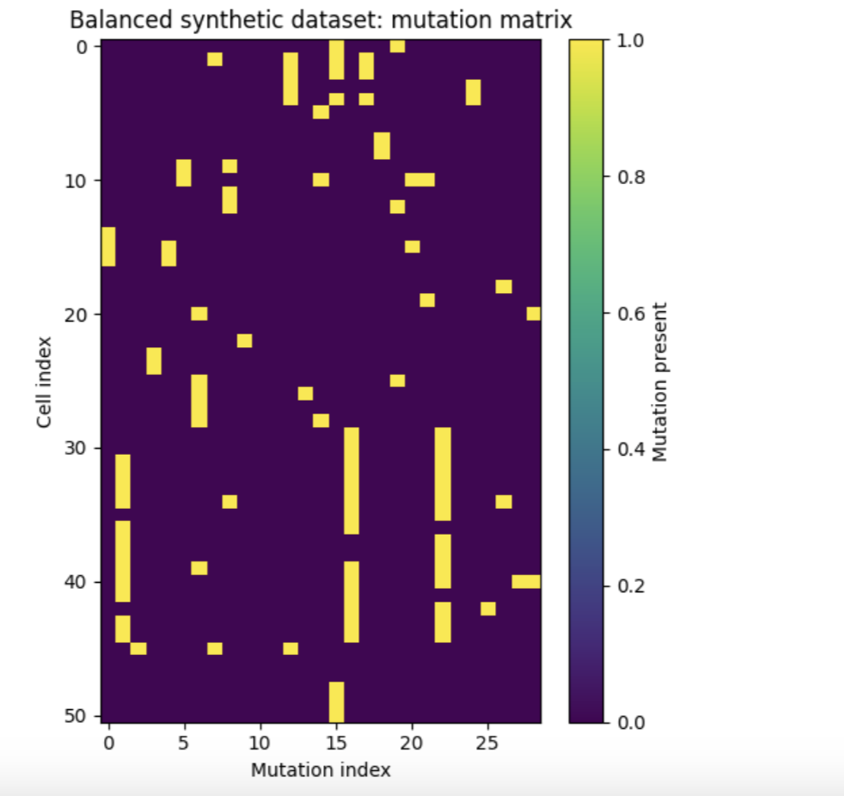
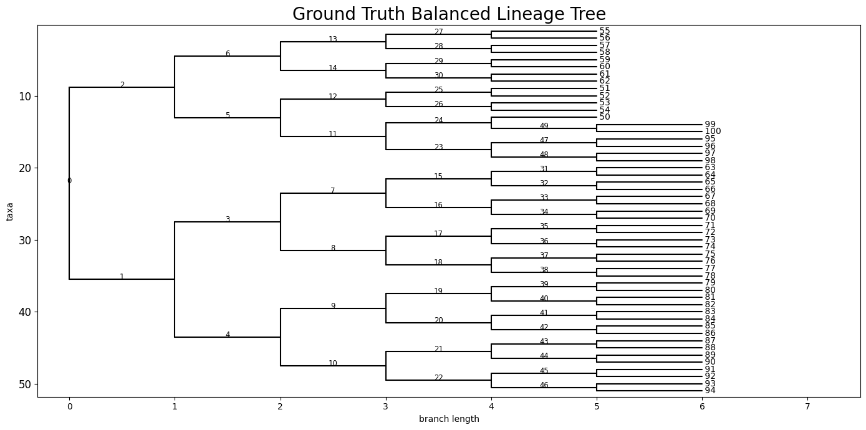
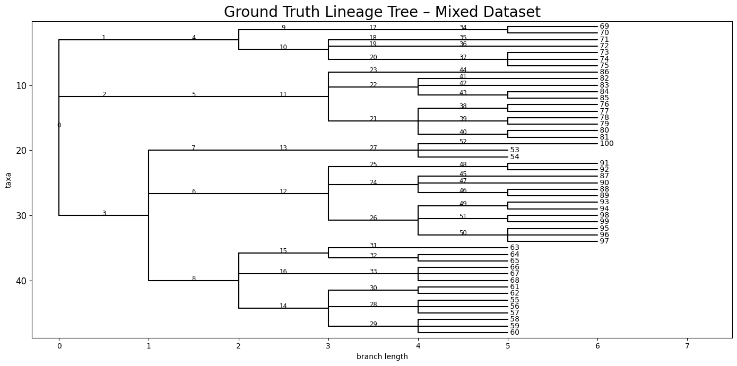
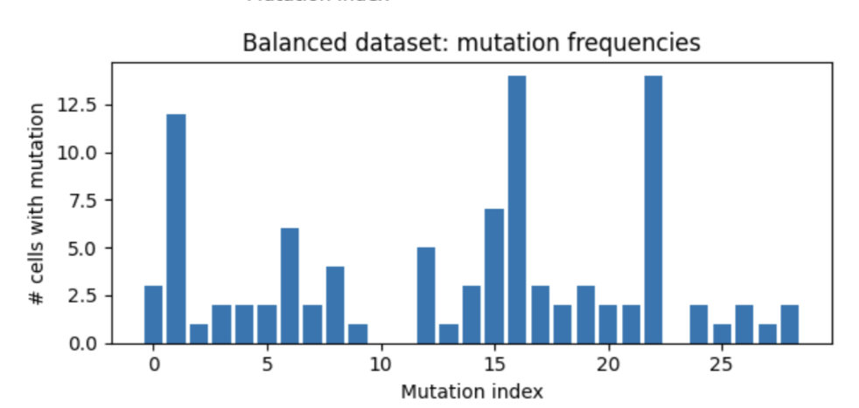
Ground-Truth Datasets for Benchmarking
Synthetic data gives us a ground truth baseline
Notes:
Before running SCITE, PhyloWGS, or LinTIMaT, we first needed ground-truth lineage structures to benchmark them against. I generated these, which gives us full control over how tumor evolution behaves.
On the left, the balanced tree represents an idealized tumor where each branch splits evenly. This creates very clean clonal structure, which helps us see whether an algorithm can accurately recover simple, low-noise evolutionary patterns.
The mixed tree below it is intentionally much less regular. Real tumors rarely evolve symmetrically, so this gives us a more realistic and challenging scenario. Comparing algorithm performance across these two extremes lets us evaluate not only accuracy, but also robustness to complexity.
On the right, the mutation matrix shows how these lineage structures translate into actual observed data — each row is a cell and each column is a mutation. The block patterns correspond directly to the branching patterns in the ground-truth tree. Beneath it, the mutation frequency histogram shows which mutations are clonal and which are subclonal, again reflecting the evolutionary structure.
Together, these visuals show the entire pipeline: we begin with a known lineage tree, generate corresponding mutation data, and then later use SCITE and PhyloWGS to see how closely their inferred trees match the truth. This establishes the baseline for all of our downstream benchmarking.
Before running SCITE, PhyloWGS, or LinTIMaT, we needed ground-truth trees, so I generated them to control how the tumor evolves.
On the left, the balanced tree shows clean, even splits, which tests accuracy on simple evolution.
Below it on the left, the mixed tree is irregular and more realistic, which tests robustness to complex patterns.
On the right, the mutation matrix shows how these trees translate into observed data, and the histogram shows clonal versus subclonal mutation frequencies.
Together, this gives us a full pipeline from known truth to simulated data, letting us see how closely each method recovers the real lineage.

Slide 7
Neighbor-Joining
Goal: Reconstruct a lineage tree using a simple, fast distance-based approach.
Inputs:
Binary cell × mutation matrix
Pairwise distance matrix derived from mutation profiles
  (e.g., Jaccard distance on mutation presence/absence)
Neighbor-Joining (NJ) is a fast, distance-based phylogenetic algorithm that constructs a tree by iteratively joining the closest pairs of nodes based on mutation-derived distances. It makes no explicit evolutionary or noise assumptions and relies solely on similarity between samples. Because of its simplicity and speed, NJ is used as a baseline to contextualize more sophisticated tumor-aware lineage methods. The output is a single distance-based lineage tree in Newick format.
Notes:
Our first algorithm, Neighbor-Joining, is a fast, distance-based method that we included as a simple control. It builds a tree from Jaccard distances between mutation profiles without modeling tumor evolution or sequencing noise. Because it is assumption-light and extremely fast, Neighbor-joining provides us a baseline.

Slide 8
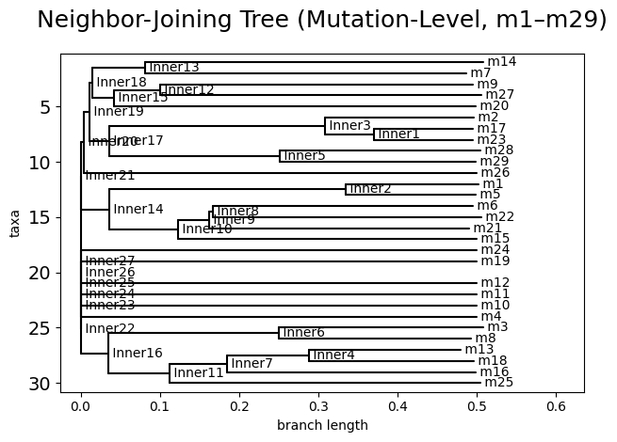
Neighbor-Joining Results
NJ serves as a fast, intuitive mutation-level reference tree that anchors our comparisons to more complex lineage-inference tools
Dataset: balanced synthetic dataset (51 cells, 29 mutations)
Method:
Input: binary mutation matrix
Distance metric: Jaccard distance between mutations
Output: mutation-level tree (labels: m1–m29)
Runtime: < 1 seconds
Notes:
Neighbor-Joining results on the balanced synthetic dataset produce a mutation-level tree, where each leaf represents a mutation. The method runs in under one second and, while not biologically interpretable, it serves as a fast reference baseline for comparison with single-cell–specific lineage methods.

Slide 9
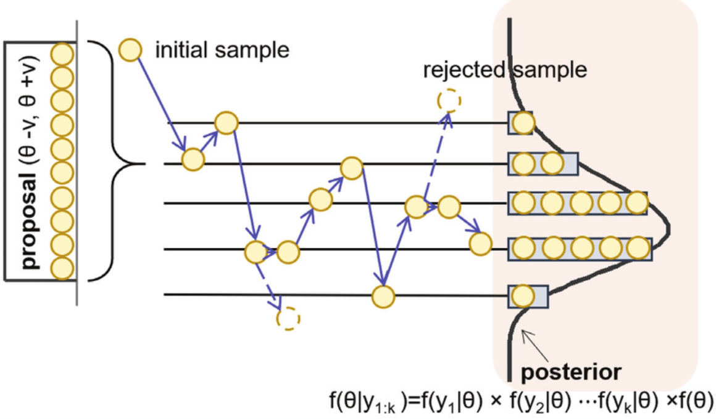
SCITE
Goal: Reconstruct cell lineage trees from noisy single-cell mutation data.
Inputs:
Binary cell × mutation matrix
Estimated sequencing error rates:
  α = false positive rate
  β = allelic dropout / false negative rate
SCITE formulates cell lineage reconstruction as a probabilistic inference problem over mutation events and tree structures. Given a binary cell-by-mutation matrix, it uses maximum likelihood estimation with MCMC sampling to infer mutation order and lineage topology while explicitly modeling single-cell sequencing errors such as false positives and allelic dropout. The method outputs maximum-likelihood lineage trees in Newick format along with posterior samples over mutation histories, enabling uncertainty assessment, performance benchmarking, and downstream comparison to ground-truth lineages.
Notes:
Next, we move to SCITE (SITE), which is explicitly designed for noisy single-cell mutation data.
SCITE is our main mutation-based lineage inference method. It uses maximum-likelihood inference with MCMC to jointly infer mutation order and lineage structure while explicitly modeling sequencing noise.

Slide 10
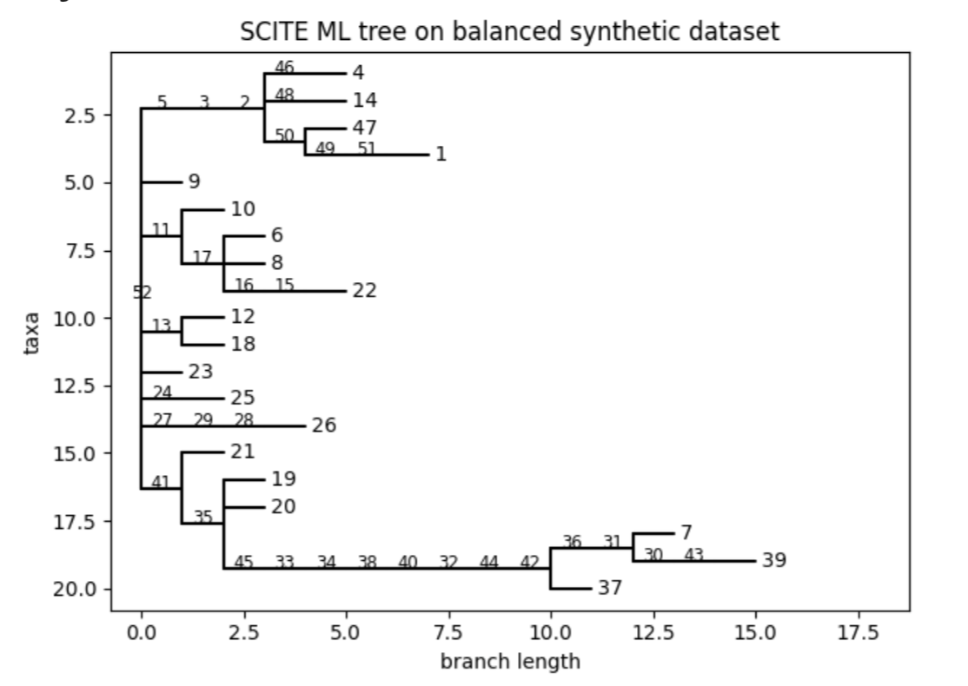
SCITE Results
SCITE recovers major branches but may miss fine structure
Dataset: balanced synthetic dataset (51 cells, 29 mutations)
SCITE settings:
False negative rate β = 0.10
False positive rate α = 0.05
Maximum likelihood (ML) tree from SCITE
Runtime: ~193 seconds on this dataset
Interpretation:
SCITE recovers a branching clonal structure consistent with the “balanced” design of the synthetic tree
This gives us a baseline lineage for comparison against PhyloWGS and other methods
Notes:
SCITE’s maximum-likelihood tree on the dataset recovers major aspects of the symmetric ground-truth structure. However, several cells attach near the root, producing broom-like patterns rather than clean splits. This flattening results from SCITE’s infinite-sites assumption, which resolves mutation conflicts by collapsing branches, leading to under-separation of some true clonal groups.

Slide 11
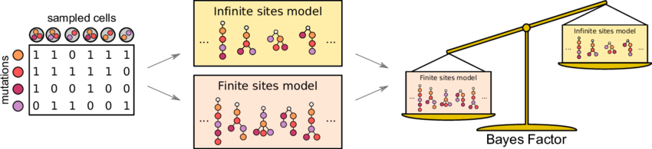
Phylogeny Inferred Using SiFit (Finite-Sites Model)
Goal: Reconstruct tumor lineage trees from noisy single-cell mutation data under a biologically realistic mutation model.
SiFit reconstructs tumor lineages using a maximum-likelihood framework under a finite-sites mutation model, allowing mutations to recur or be lost while explicitly modeling sequencing errors. By relaxing the infinite-sites assumption made by tools like SCITE, SiFit captures more biologically realistic mutation processes, often resulting in deeper and more complex lineage trees.
Inputs:
Binary cell × mutation matrix
Estimated sequencing error parameters
  False positive rate
  False negative (dropout) rate
Notes:
SiFit reconstructs tumor lineages using a maximum-likelihood finite-sites model, allowing mutations to recur or be lost. Unlike infinite-sites methods, this better reflects realistic cancer mutation processes. Using the same binary cell-by-mutation matrix and specified error rates, SiFit searches for the lineage tree that best explains the observed mutation patterns.

Slide 12
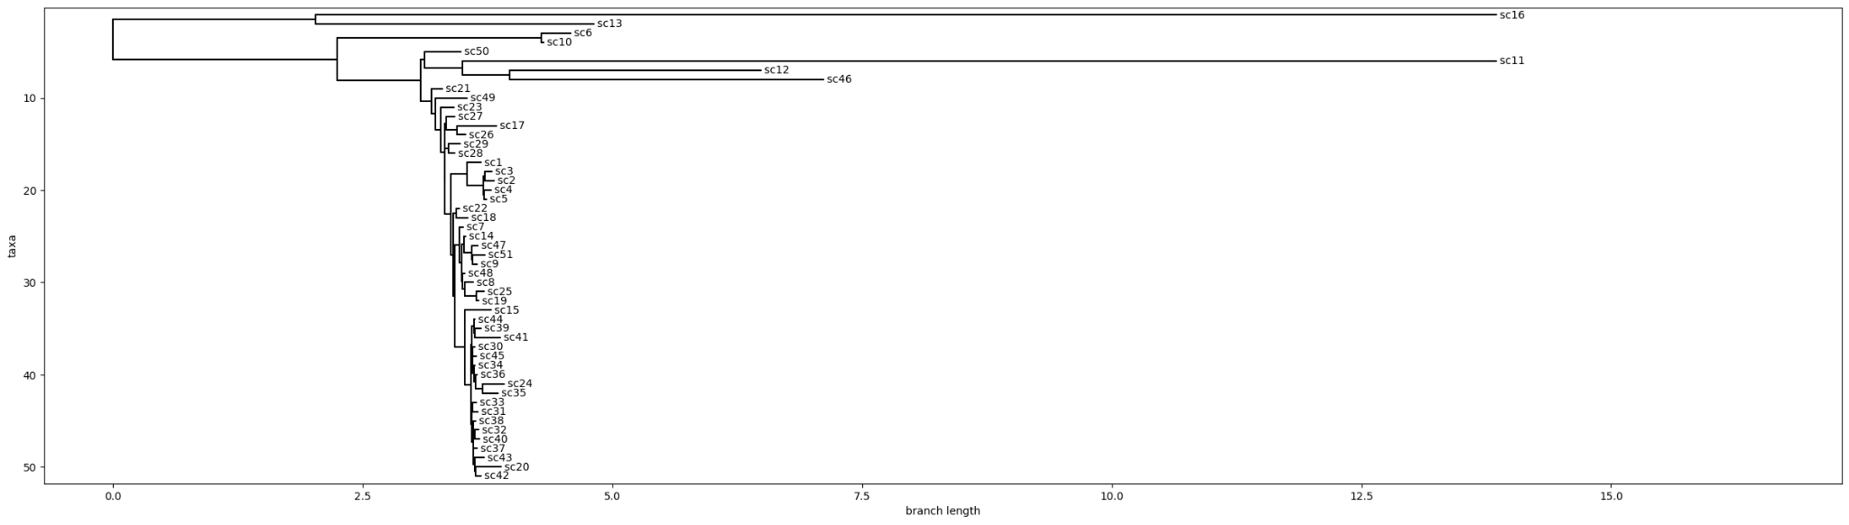
SiFit Results
SiFit offers a finite-sites perspective on the same dataset, revealing mutational patterns that infinite-sites tools may miss
Dataset: balanced synthetic dataset (51 cells, 29 mutations)
SiFit settings:
False negative rate (FN) = 0.10
False positive rate (FP) = 0.01
Finite-sites evolutionary model
10,000 iterations (maximum likelihood search)
Binary mode (-df 0, required for SC matrices)
Output: Maximum likelihood mutation tree
Runtime: ~7 seconds
Interpretation:
SiFit reveals deeper, more uneven branching consistent with real tumor subclonal diversity rather than the clean symmetry seen in synthetic data
Long isolated branches highlight heterogeneous mutation burdens, suggesting biologically distinct subpopulations rather than uniform clonal expansion.
Notes:
We now apply SiFit to real single-cell tumor data. Unlike our other algorithms allows recurrent and back-mutations, making it more suitable for noisy real data. The resulting tree is much deeper and more irregular than those from the synthetic balanced dataset, reflecting increased tumor heterogeneity. This highlights how lineage complexity grows substantially when moving from controlled synthetic data to real tumors.

Slide 13
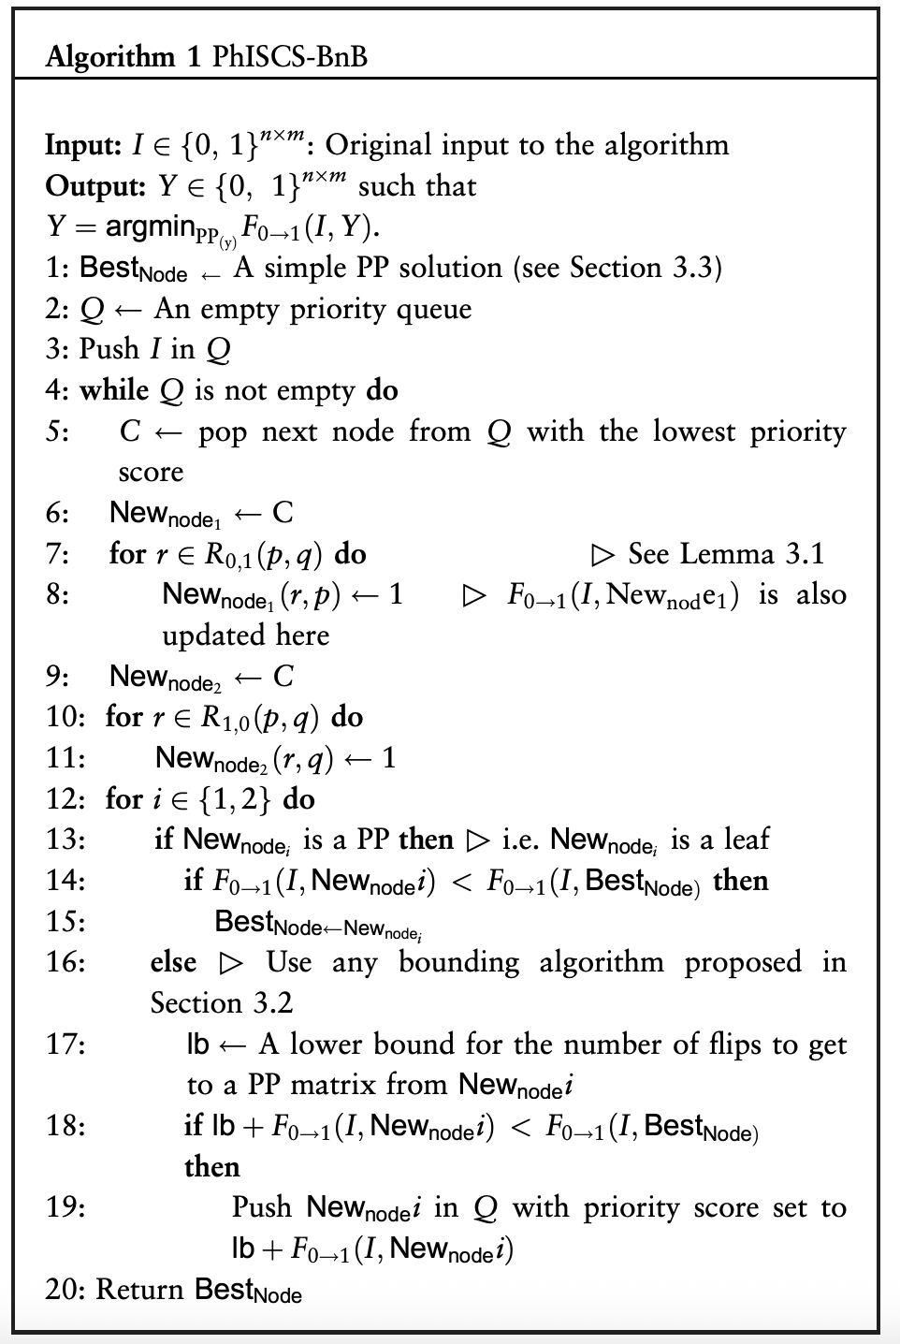
PhISCS-BnB
Goal: Infer a clonal lineage tree that satisfies perfect-phylogeny constraints from single-cell mutation data.
Inputs: Binary cell × mutation matrix (cells × mutations)
PhISCS-BnB reconstructs tumor phylogenies by formulating lineage inference as an integer linear programming (ILP) problem solved via branch-and-bound optimization. It enforces a perfect-phylogeny model, where each mutation arises once and is never lost, and finds an optimal solution under these constraints rather than relying on probabilistic sampling. The method outputs a clonal lineage tree in Newick format, optionally with mutations annotated on branches, but can be sensitive to noise and sparse mutation signals due to its strict phylogenetic assumptions.
Notes:
PhISCS-BnB infers clonal lineage trees by solving an integer linear programming (ILP) problem using branch-and-bound optimization. It enforces a perfect-phylogeny model, where each mutation arises once and is never lost, and returns an optimal clonal tree rather than sampling multiple solutions. Due to its strict constraints, PhISCS-BnB can be sensitive to noise and sparse mutation signals.

Slide 14
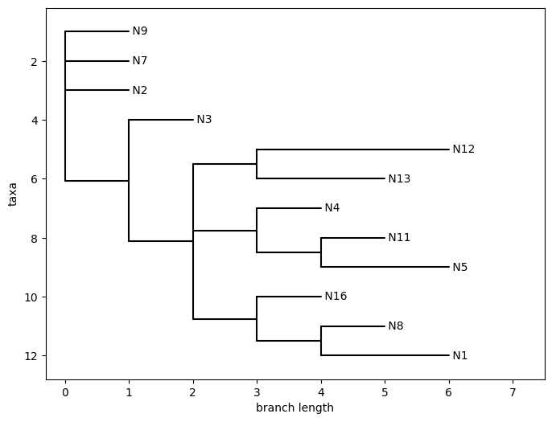
PhISCS-BnB Results
Dataset: balanced synthetic dataset (51 cells, 29 mutations)
SCITE settings:
Branching factor b = 2
Draw tree t = 1
Runtime: ~53 seconds on this dataset
Interpretation:
Unlike SCITE, requires every mutation occurs once and does not revert - causes shallow tree, limited branching
Over-simplify lineage structure when the dataset contains noise
Notes:
This slide shows that PhISCS-BnB perfect-phylogeny tree for the same dataset. Because PhISCS-BnB enforces that each mutation occurs only once and never reverts, it produces a much shallower and more rigid tree. While the result is clean and consistent, much of the balanced branching structure is compressed into a few major clonal splits, indicating that strict perfect-phylogeny assumptions can over-simplify lineage structure in noisy data.

Slide 15
Comparison of Mutation-Based Lineage Inference Methods
They all start from the same single-cell mutation matrix, but they make very different assumptions, which is why their trees diverge
Feature | SCITE | SiFit | PhISCS-BnB | Neighbor-Joining
Primary data | Single-cell mutation matrix | Single-cell mutation matrix | Single-cell mutation matrix | Mutation-derived distances
Evolutionary model | Infinite sites | Finite sites (allows repeated mutations) | Perfect phylogeny (ILP) | None (distance-based)
Handles dropout/noise | Yes (α, β model) | Yes (explicit error model) | Limited (constraint-based) | No explicit noise modeling
Output structure | Single ML cell lineage tree | Single full mutation tree | Clonal tree (mutations on edges) | Tree based on similarity
Computational cost | Moderate (MCMC) | Fast | Moderate | Very fast
Strength | Robust to scRNA-seq noise | Biologically realistic mutation model | Guarantees phylogenetic consistency | Simple, assumption-free baseline
Limitation | Infinite-sites assumption | Can produce deep/complex trees | Sensitive to noise/constraints | Not tumor-aware
Observed in our project | Recovers some balanced structure but collapses branches under conflict | Produces rich structure on real tumor data; captures heterogeneity | Over-simplifies synthetic balanced tree into few large clones | Mismatches ground truth; non-biological bushy shape
Notes:
“This slide pulls everything together and compares how the four methods actually behaved on our synthetic ground-truth dataset.
SCITE recovered parts of the balanced structure, but whenever the matrix contained conflicting mutation patterns, it tended to collapse branches. So the higher-level shape was recognizable, but finer clonal splits were lost.
SiFit went in the opposite direction — it produced one of the most detailed trees. It captured heterogeneity well, but it also created very deep, complex branching that wasn’t present in the ground truth, likely because its finite-sites model interprets noise as repeated mutation events.
PhISCS-BnB dramatically over-simplified the lineage. Instead of reconstructing the full balanced structure, it merged much of the tree into just a few large clones. That happened because perfect-phylogeny constraints force the algorithm to resolve conflicts by collapsing structure.
And Neighbor-Joining gave us a tree that looked the least biological. It produced a bushy, similarity-based structure that didn’t match the balanced truth at all. This really highlighted the limits of using purely distance-based approaches for tumor evolution.
So overall, even with the same input data, the methods produce very different lineages — and the differences map directly onto how each model treats noise, conflicts, and mutation recurrence.

Slide 16
Methods Not Aligned to Our Synthetic Setup
PhyloWGS:
Designed for bulk sequencing VAFs
Our binary single-cell genotypes violate its assumptions → flat posterior, no consensus tree
LinTIMaT:
Requires mutation + expression matrices
Mutation-only data breaks its model → cannot infer trajectories
OncoNEM:
Assumes infinite-sites and low noise
Our noisy mutation model makes it return oversimplified trees
Notes:
We also found several methods that didn’t produce meaningful results on our dataset.
PhyloWGS is meant for bulk VAF data, not single-cell genotypes. When given our matrix, its posterior became flat, and the algorithm couldn’t identify a single tumor origin, shown in the photo. Because of that, it wouldn’t report a consensus tree.
Likewise, LinTIMaT needs both expression and mutation data and OncoNEM assumes almost no noise. Under our synthetic mutation-only setup, none of these produced usable lineage results.

Slide 17
Next Steps
Apply SCITE, SiFit, PhISCS-BnB, and Neighbor-Joining to a real single-cell tumor mutation dataset, verify conclusions from synthetic datasets
Compare real-data lineage structures to synthetic benchmark behavior, create numeric ranking method to compare trees
Aggregate results and draw biological interpretation running all four methods in a single real dataset
Summarize tradeoffs to provide guidance on method selection for different data types
Notes:
Extend synthetic benchmarks: Test all methods on mixed/heterogeneous trees to see if depth, stability, and noise trends hold.
Complete quantitative accuracy evaluation: Compute RF, ARI, and edge-precision metrics to produce numeric accuracy rankings.
Apply to real data: Run all methods on a real single-cell mutation matrix and compare results to synthetic behavior.
Analyze Results: Use findings to summarize method trade-offs and give practical “when to use what” recommendations.

Slide 18
Citations
Jahn et al., SCITE: Inferring tumor evolution from single-cell sequencing, Bioinformatics (2016)
Morrissy et al., Single-cell characterization of medulloblastoma reveals therapy-induced stemness, Nature (2024)
Satas & Raphaël, Accurate, fast, and memory-efficient inference of single-cell phylogenies, Genome Research (2020)
Ogawa et al., Computer-assisted DNA phylogeny reconstruction based on restriction enzyme cleavage patterns, Gene (1987)
Notes:
Image on slide 2: https://www.researchgate.net/figure/Schematic-representation-of-somatic-cancer-evolution-as-a-phylogenetic-tree-Different_fig2_319625078
Image on slide 10: https://www.researchgate.net/figure/Testing-the-infinite-sites-assumption-starts-from-the-single-cell-mutation-data-The-data_fig2_345741782
PhiSCS: https://pubmed.ncbi.nlm.nih.gov/32657358/

